Slide 1
Multi-Tier System of Supports (MTSS) and Universal Screening for Mental Health and Behavior
District Advisory Council August 2020
Katharine Williams, LMHC
Director of Mental Health and Behavioral Supports

Slide 2
What is MTSS?
Okeechobee County School Board is committed to organizing the existing educational system as a Multi-Tiered System of Supports (MTSS). MTSS is a systemic approach that uses data-based problem solving and decision making across all levels of the education system for supporting students both academically and behaviorally. There are three tiers:
Tier 1 | Tier 2 | Tier 3
Designed for all students (100%) with on-going differentiated instruction | Small group problem-solving: targeted interventions for fewer than 15% of students | Individualized problem solving: intensive and strategic intervention focused on specific skills for fewer than 3-5% of students

Slide 3
Goals of MTSS
Our goal for our Students:
The MTSS framework allows students to be known, respected and supported across the diversity of their learning needs, so they may achieve success in their academics, personal relationships, and lives.
Our goal for our Educators:
Educators see this MTSS framework as a way to support all students more effectively, more easily, and more efficiently. We aim to streamline the collection and documentation of observations and student data - as well as the planning and reporting process required for differentiation and intervention, so we can enable our teachers to spend more time building relationships with their students, delivering personalized support, and experiencing professional success in a framework that provides support in a shared responsibility model.
Notes:
Pat:

Slide 4
Why use a Multi-Tiered System of Supports?
So EVERY student can achieve academic and life success. MTSS is one of the most effective ways to provide an equitable educational experience, because it leverages collective knowledge and expertise to help teachers understand their learners’ needs and make informed and strategic decisions that best support them.
Notes:
Kathy: MTSS begins with teachers assessing the skills of everyone in the class to proactively identify who may need additional topic support (e.g., reading, math, and behavior). Students then receive support (research-based, targeted instruction or intervention) matched both to their skills and level of need. Those students’ progress is monitored closely to ensure that the additional support is helping. If the achievement gap has resolved, the additional support in that area is no longer required; if it does not improve, then the level of personalization increases. This practice allows for early interventions that are more productive and better for the child.

Slide 5
Branching Minds
As part of the district reorganization of our MTSS process, we have collaborated with Branching Minds. Branching Minds is a cloud-based platform that will streamline and personalize student supports using evidenced-based intervention. Through this platform, the district will be better able to effectively and efficiently identify students in need of support, identify the root of their challenges, and streamline their intervention process to promote better success. A main goal of better streamlining this process is to increase the amount of time student services personnel (i.e. school counselors, crisis counselors, school social worker, youth coordinator, behavior interventionists) spend providing direct mental health services.

Slide 6
Behavior and Mental Health Universal Screening
As part of our MTSS process and in line with Senate Bill 7030 written into law in 2019, Okeechobee County Schools participates in a Universal Screening Process of all students. This is a mental health/behavioral form supported by the Positive Behavioral Interventions and Supports (PBIS) system. This form will be used to help school administration, leaders, and teachers nominate students based on the prevalence and early development of both externalizing (i.e. manipulating behaviors, disrespect, aggression, etc.) and internalizing behaviors (i.e. isolating behaviors, anxiety, depression, etc.).
The form will be available for all students; however, the district will adopt a triage approach where the students with the highest scores will be nominated for immediate Tier 2 or Tier 3 supports. This process will happen up to three times per school year. The school based teachers and school counselor(s) will nominate the students, and school staff as well as school and district based mental health professionals will facilitate interventions based on the needs of the students. All Tier 3 meetings held will require parent notification.

Slide 7
Behavior and Mental Health Universal Screening
What will Okeechobee County Schools use to implement and monitor Universal Screening?
Universal Screener Tier Rubric to be used up to 3x per year
Universal Screener Worksheet
Progress Monitoring Tools for Elementary, Middle, and High

Slide 8
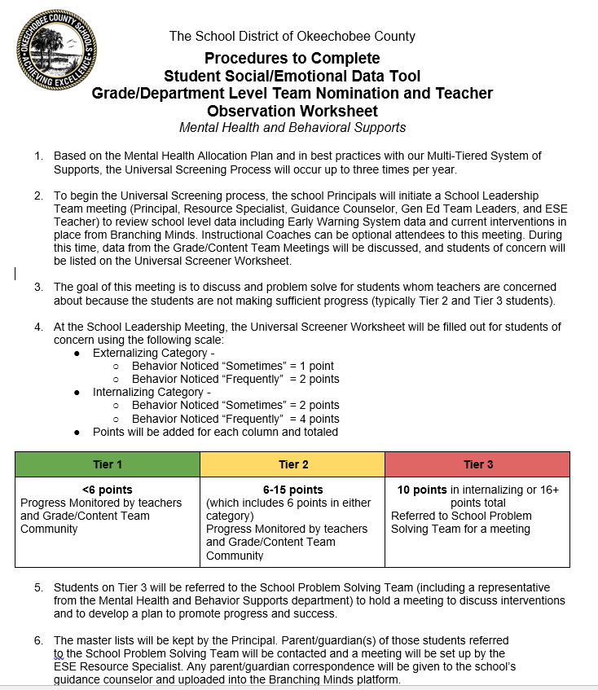

Slide 9
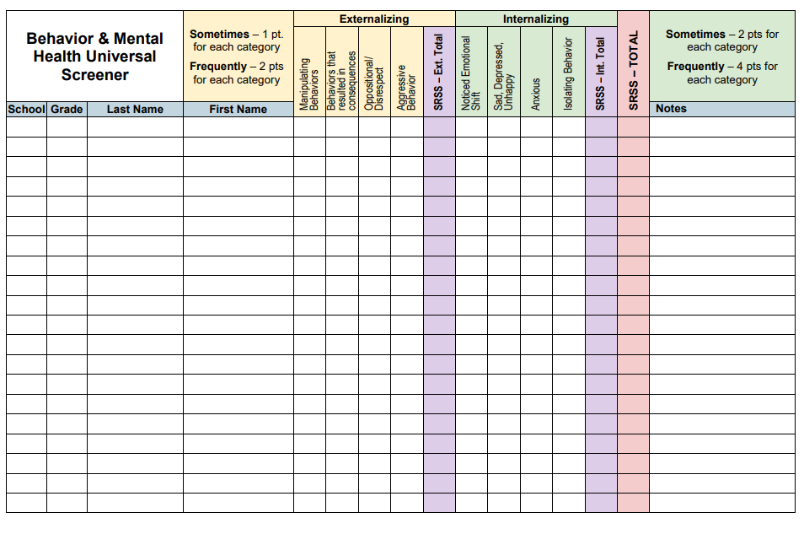

Slide 10
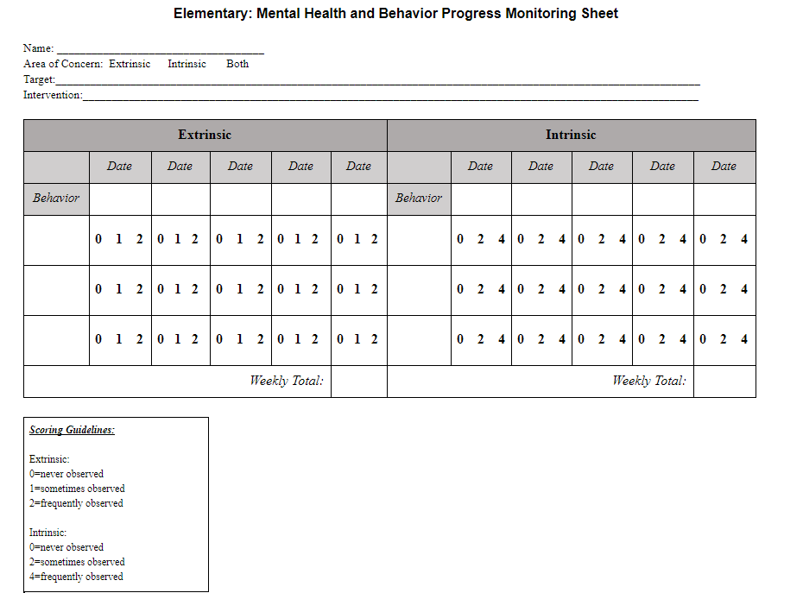

Slide 11
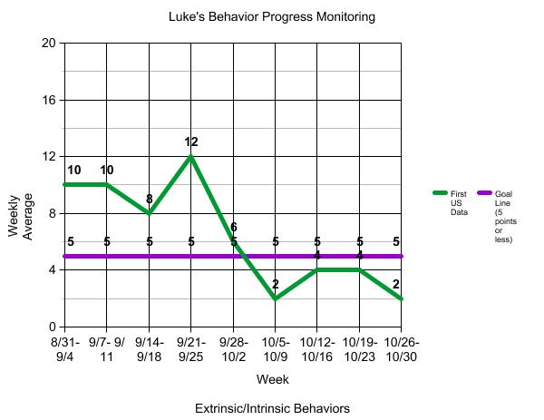
Progress Monitoring
Progress Monitoring is completed weekly (for nine weeks) for students receiving Tier 2 and 3 supports. The Assistant Principal is responsible for ensuring that the monitoring is occurring with fidelity.
Some variability is normal from week to week based on academic performance, mental health, and other precipitating factors.
When looking at graphed data, we want to see the trend line below the goal line for four consecutive weeks before moving down a tier.

Slide 12
Virtual Universal Screening
*The screening process looks different for virtual students (the screening process is still developing)
What will prompt a screening process for a student?
Referral from a teacher or another staff member working with a student
EWS indicators (lack of attendance, low academic performance, decreased participation, etc.)
Concerns after a virtual check-in
When a concern arises because of one of the above indicators, the staff member takes the concern to the school’s leadership team immediately, and well-informed, data-based decisions about the student’s well-being are made. The school will work collaboratively with parents, district mental and behavioral health staff, and community providers regarding student needs.

Slide 13
When Will We Facilitate the Screenings?
September 14th - October 2nd (meet, make list, and create tier plans)
January 25th - February 12th (meet, make list, and create tier plans)
This should give us time to get interventions put into place before the holidays and will ensure that we can get interventions into place well before the end of the year.

Slide 14
Questions?

