Slide 1
Understanding Learning Gains
Notes:
Collaborative conversations related to learning gains.
Preface: not from ARM, we didn’t make or set the scales. This is not VAM. This is a one year growth, VAM is a three year growth.

Slide 2
Objectives
Participants will:
Examine State Rules regarding how learning gains will be determined using the Florida State Assessments
Explore Learning Gains scenarios
Notes:
During this presentation we will examine the State Rules regarding how learning gains will be determined using the Florida State Assessments; we will Explore Learning Gains scenarios.

Slide 3
Learning Gains RULE NO.:6A-1.09981
Learning gains:
Measurement of growth from one year to the next year
Growth must sufficiently meet the prescribed criteria
May be demonstrated in English Language Arts and Mathematics
Notes:
What is a learning gain? A “Learning gains” means that the student demonstrates growth from one year to the next year sufficient to meet the criteria below. Learning gains may be demonstrated in English Language Arts and Mathematics. Students may demonstrate learning gains in four (4) different ways.

Slide 4
Learning Gains Rule #1:
Students who increase at least one (1) achievement level on the statewide standardized assessment in the same subject area.
Move from Level 1 to Level 2
Move from Level 2 to Level 3
Move from Level 3 to Level 4
Move from Level 4 to Level 5
MATH | Level 1 |  |  |  | Level 2 |  |  | Level 3 | Level 4 | Level 5
Assessment | Level 1 | Low | Middle | High | Level 2 | Low | High
Grade 3 | 240-284 | 240-254 | 255-269 | 270-284 | 285-296 | 285-290 | 291-296 | 297-310 | 311-326 | 327-360
Grade 4 | 251-298 | 251-266 | 267-282 | 283-298 | 299-309 | 299-304 | 305-309 | 310-324 | 325-339 | 340-376
Notes:
The first way that a student can demonstrate a learning gain is to increase at least one (1) achievement level on the statewide standardized assessment in the same subject area.
Students can move from level 1 to level 2, level 2 to level 3, level 3 to level 4 and level 4 to level 5.

Slide 5
Learning Gains Rule #2:
Students who advance from one sub-level within Achievement Level 1 or 2 in the prior year to a higher sub-level in the current year in same subject area.
ELA | Level 1 |  |  |  | Level 2 |  |  | Level 3 | Level 4 | Level 5
Assessment |  | Low | Middle | High |  | Low | High
Grade 3 ELA |  | 240-254 | 255-269 | 270-284 |  | 285-292 | 293-299 | 300-314 | 315-329 | 330-360
Grade 4 ELA |  | 251-266 | 267-281 | 282-296 |  | 297-303 | 304-310 | 311-324 | 325-339 | 340-372
Move from a Low 1
to
Middle 1
Move from a Middle 1 to
High 1
Move from a Low 2
to
High 2
Notes:
The second way that a student can demonstrate a learning gain is for a student to advance from one sub-level within Achievement level 1 or 2 in the prior year to a higher sub-level in the current year in the same subject area.
Move from a low one to a middle, high one to a low two, is a learning gain. Satisfied both rules but there are no bonus points for satisfying more than one rule.
You have to go diagonally to the next grade level every time (not 240 to 255 but 240 to 267) Low 2 to a high 2 is a learning gain, they would have to move from a high 2 to a level 3
Movement from one bucket to the next bucket.
Rule 2:27 points seen as a huge point spread (see notes on next slide).

Slide 6
Learning Gains Rule #3:
Students whose score remained at Achievement Level 3 or 4 on the statewide standardized assessment in the current year and whose scale score is greater in the current year than the prior year in the same subject area.
Math Assessment | Level 3 | Level 4
Grade 4 | 310-324 | 325-339
Grade 5 | 320-333 | 334-349
If previous year scale score exceeds this number then student needs to gain one (1) point.
If previous year scale score exceeds this number then student needs to gain one (1) point.
The one (1) point rule only applies to achievement Level 3 and Level 4.
Mathematics EOCs are exempt from the (1) point rule.
Notes:
The third way that a student can demonstrate a learning gain is for a student whose score remains at achievement level 3 or 4 on the statewide assessment in the current year and whose scale score is greater in the current year than the prior year in the same subject area. This is the one point rule you often hear about. This does not apply to math EOCs.
You want to look at it is as what is my first threshold or cut score for my next grade level?
A level 4 might need 10 points to maintain a level 4.
If I’m in grade 4, I scored a 324 not only must I maintain that score, I must maintain it by one point.

Slide 7
Learning Gains Rule #4:
Students who scored at Achievement Level 5 in the prior year on the statewide standardized assessment and who score in the same Achievement Level in the current year in the same subject area.
ELA Assessment | Level 5
Grade 3 | 330-360
Grade 4 | 340-372
Please note: EOC Mathematics Levels 3 & 4 can also decrease in score but still count as a learning gain!
If student’s scale score in grade 3 was 360 and in grade 4 the student scored a 340, then student is still counted as a learning gain because the student maintained a level 5.
Notes:
The fourth way that a student can demonstrate a learning gain is by maintaining a level 5.
EOCs do not abide. They play by their own rule for levels 3,4. 1 & 2 needs to move a subcategory.

Slide 8
Learning Gains Rules Recap:
#1 > Student moves an achievement level
#2 > Student moves an achievement sublevel
#3 > Student maintains an achievement level 3 or 4 and increases score
#3a > Minimum of 1pt
#3b > Exception: Mathematics EOC Levels 3 and 4
#4 > Student maintains an achievement level 5
Let’s explore some learning gains scenarios!
Notes:
1 Move a level
2 Move a sub level
3 Maintain and increase as one
EOC exceptions
4 Student maintains an achievement level 5

Slide 9
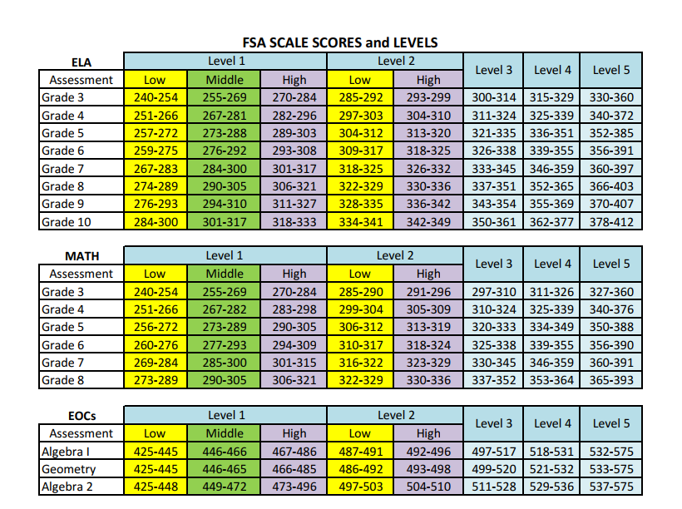
Learning Gains Activity
Print the FSA Scale Scores and Levels document to use as a reference.

Slide 10
Elementary Exploration of Learning Gains
School Year | Assessment | Grade
15-16 | FSA-ELA | 4th | Baseline score: 251 (L1-L)
16-17 |  | 5th | Min. score needed for LG?
 |  |  | Min. # of points for LG?
 |  |  | Achievement Level?
#1
273
22
L1-M
#2
School Year | Assessment | Grade
15-16 | FSA-MATH | 3rd | Baseline score: 284 (L1-H)
16-17 |  | 4th | Min. score needed for LG?
 |  |  | Min. # of points for LG?
 |  |  | Achievement Level?
299
15
L2-L
Notes:
For the next examples you will want to look at the FSA Scale Scores and Levels document.
In example #1, a 4th grade student scored a 251 which is low level 1 in ELA. For that student to make a learning gain as a 5th grade student they would need to score a 273. This would move them up to the Level 1 Middle range.
In example #2, a 3rd grade student scores a 284 which is a high level 1 in math. For that student to make a learning gain as a 4th grade student they would need to score a 299. They would need to increase by 15 points to move them to the low level 2 range.

Slide 11
Elementary Exploration of Learning Gains
School Year | Assessment | Grade
15-16 | FSA-ELA | 3rd | Baseline score: 329 (L4)
16-17 |  | 4th | Min. score needed for LG?
 |  |  | Min. # of points for LG?
 |  |  | Achievement Level?
#3
330
1
L4
#4
School Year | Assessment | Grade
15-16 | FSA-MATH | 4th | Baseline score: 341 (L5)
16-17 |  | 5th | Min. score needed for LG?
 |  |  | Min. # of points for LG?
 |  |  | Achievement Level?
350
9
L5
Notes:
In this example, student #3 earned a score of 329 on the 3rd grade ELA assessment. For the student to make a learning gain they would need to increase their score to 330 which is just one point.
In the next example, student #4 earned a 341 on the 4th grade math assessment. For the student to make a learning gain they would need to increase their score by 9 points to a 350 in order to maintain a level 5.

Slide 12
Elementary Exploration of Learning Gains
School Year | Assessment | Grade
15-16 | FSA-ELA | 4th | Baseline score: 372 (L5)
16-17 |  | 5th | Min. score needed for LG?
 |  |  | Min. # of points for LG?
 |  |  | Achievement Level?
#5
352
-20
L5
#6
School Year | Assessment | Grade
15-16 | FSA-ELA | 3rd | Baseline score: 240 (L1-L)
16-17 |  | 3rd | Min. score needed for LG?
 |  |  | Min. # of points for LG?
 |  |  | Achievement Level?
255
15
L1-M
Notes:
There are six elementary examples because there always seams to be a lot of questions in elementary.
#6 was built in for a retainee student.
Tell a story
Student in grade 3, excited to test, take the text, text mark, they try, they’re the third student to finish. They think the test was easy. They shot a 340. In good faith he’s retained. What must the student achieve to be a learning gain. A 255. Any grade where they were retained we go straight across.

Slide 13
Middle Grades Exploration of Learning Gains
School Year | Assessment | Grade
15-16 | FSA-ELA | 5th | Baseline score: 257 (L1-L)
16-17 |  | 6th | Min. score needed for LG?
 |  |  | Min. # of points for LG?
 |  |  | Achievement Level?
#7
276
19
L1-M
#8
School Year | Assessment | Grade
15-16 | FSA-MATH | 5th | Baseline score: 319 (L2-H)
16-17 |  | 6th | Min. score needed for LG?
 |  |  | Min. # of points for LG?
 |  |  | Achievement Level?
325
6
L3
Notes:
Middle Grades #7 is Rule 2; #8 is low to high

Slide 14
Middle Grades Exploration of Learning Gains
School Year | Assessment | Grade
15-16 | FSA-ELA | 6th | Baseline score: 337 (L3)
16-17 |  | 7th | Min. score needed for LG?
 |  |  | Min. # of points for LG?
 |  |  | Achievement Level?
#9
338
1
L3
#10
School Year | Assessment | Grade
15-16 | FSA-MATH | 7th | Baseline score: 367 (L5)
16-17 |  | 8th | Min. score needed for LG?
 |  |  | Min. # of points for LG?
 |  |  | Achievement Level?
365
-2
L5
Notes:
#10 is the last example of traditional student progression

Slide 15
Middle Grades Exploration of Learning Gains
School Year | Assessment | Grade
15-16 | FSA-MATH | 7th | Baseline score: 337 (L3)
16-17 | FSA-ALGEBRA I |  | Min. score needed for LG?
 |  |  | Achievement Level?
#11
497
L3
#12
School Year | Assessment | Grade
15-16 | FSA-MATH | 7th | Baseline score: 367 (L5)
16-17 | FSA-ALGEBRA I |  | Min. score needed for LG?
 |  |  | Achievement Level?
532
L5
Notes:
What happens when we go from grade 7 math to algebra 1?
One point score does not apply. At this time the number of points doesn’t matter, it’s the level. If you’re looking at points and sublevels, the sublevel will win.
It’s all relative to the cognitive complexity. Keep in mind that as long as our students are on that track, they’ll acquire the level.
Grade six to Algebra 1. Go from the grade 6 to the Algebra 1 scale.

Slide 16
High School Exploration of Learning Gains
School Year | Assessment | Grade
15-16 | FSA-ELA | 8th | Baseline score: 274(L1-L)
16-17 |  | 9th | Min. score needed for LG?
 |  |  | Min. # of points for LG?
 |  |  | Achievement Level?
#13
294
20
L1-M
#14
School Year | Assessment | Grade
15-16 | FSA-ALG.1 |  | Baseline score: 486 (L1-H)
16-17 | FSA-GEO |  | Min. score needed for LG?
 |  |  | Min. # of points for LG?
 |  |  | Achievement Level?
486
0
L2-L
Notes:
#13 follows rule 2
#14 starts going into school grading conversations
Students scores a 486 which places him at a level 1 – H. What does the student need to score in geometry to be counted as a learning gain? 486 because you go diagonally. A 486 is a level 2 – low. As long as you move a bucket. Theoretically the student can receive the exact same score and it still moves a level.
Only 9 and 10, students going from 8 to 9 and 9 to 10 go into school grade.

Slide 17
High School Exploration of Learning Gains
School Year | Assessment | Grade
15-16 | FSA-ELA | 9th | Baseline score: 362(L4)
16-17 |  | 10th | Min. score needed for LG?
 |  |  | Min. # of points for LG?
 |  |  | Achievement Level?
#15
363
1
L4
#16
School Year | Assessment | Grade
15-16 | FSA-ELA | 9th | Baseline score: 385 (L5)
16-17 |  | 10th | Min. score needed for LG?
 |  |  | Min. # of points for LG?
 |  |  | Achievement Level?
378
-7
L5
Notes:
What is the first number for grade 10, level 5. Just the one point rule because it is an ELA-FSA, the EOC rule does not apply at this time.
Every time you see the one point remind them of the free throw analogy. Don’t miss it.
Rule reminder for EOC: just maintains.
Algebra A & B. How do we capture that? Whatever math course they take after Algebra B, you go to whatever course they take, say geometry, you go to that scale.
#16 is an example of how a student can drop points but still receive a learning gain.

Slide 18
Comparison of the Ways to Demonstrate a Learning Gain for School Grades
Old Method | New Method
Improve one or more achievement levels from one year to the next (e.g., move from Level 1 to Level 2; Level 2 to Level 4, etc.) | Same
Maintain a Level 3, Level 4, or Level 5 from one year to the next | Same, except for Level 3 and Level 4, in addition to maintaining the level, the student’s scale score must have improved from one year to the next* Exception: Mathematics EOCs
For students who remain in Level 1 or Level 2, demonstrate a specified scale score gain | Split Levels 1 and 2 into multiple sections (Level 1 into thirds and Level 2 in half) and require the student to improve from section to section within the Level (e.g., move from the bottom third of Level 1 to the middle third of Level 1)
*The way to demonstrate a learning gain for students who maintain a Level 3 or Level 4 was changed from the original draft rule language based on feedback received from FADSS and others during the rule development process
Notes:
This slide just shows you the comparison from the old method of learning gains to the new methods.

Slide 19
Logic Behind the New LG Rules
FSA MATH | Level 1 |  |  | Level 2 |  | Level 3
 | Low | Middle | High | Low | High
Grade 3 | 240-254 | 255-269 | 270-284 | 285-290 | 291-296 | 297-310
Grade 4 |  | 267-282 | 283-298 | 299-304 | 305-309 | 310-324
Grade 5 |  |  | 290-305 | 306-312 | 313-319 | 320-333
Grade 6 |  |  |  | 310-317 | 318-324 | 325-338
Grade 7 |  |  |  |  | 323-329 | 330-345
Grade 8 |  |  |  |  |  | 337-352
By this logic a grade 3 level 1-low student could be satisfactory by grade 8
Notes:
I’m new to DOE and often sit in meetings and some of the things that go on, I ask why? Generally this is going down a rabbit hole (like Alice in Wonderland and Willie Wonka). Being a secondary teacher and having students in Biology at below grade level reading. This is holding our feeder schools more accountable to our high schools. If we move a student at L1 and move them one subcategory every year, we can get them to grade level. A level one student is considered inadequate. Level 2 is unsatisfactory, Level 3 satisfactory, level 4 proficient and level 5 is succeeding.
This is the yellow brick road. Students in the previous model could be a level 1 their entire school years.

Slide 20
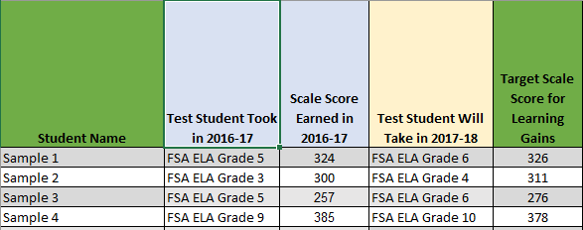
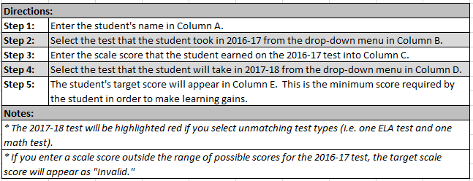
Learning Gains Target Calculator
There is a link to download a Learning Gains Target Calculator

